Slide 1
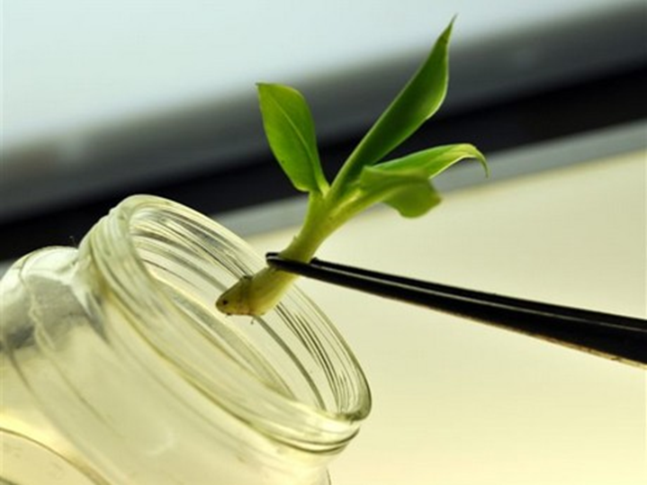
Plant tissue culture
Pharmacognosy lecture stage 2
By D. Zainab Tuama

Slide 2
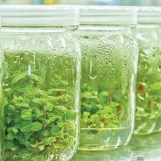
Plant Tissue Culture Applications
Plant tissue culture is a technique of growing plant cells, tissues, organs, seeds or other plant parts in a sterile environment on a nutrient medium.
The technique depends mainly on the concept of totipotentiality of plant cells which refers to the ability of a single cell to express the full genome by cell division. Along with the totipotent potential of plant cell, the capacity of cells to alter their metabolism, growth and development is also equally important and crucial to regenerate the entire plant
Adult plant cells are totipotent, meaning they have the ability to give rise to a fully differentiated plant. Because of this, it is possible to collect cells from a mature plant and use those cells to produce clones of that plant.

Slide 3
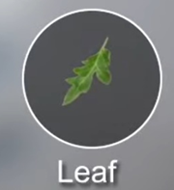
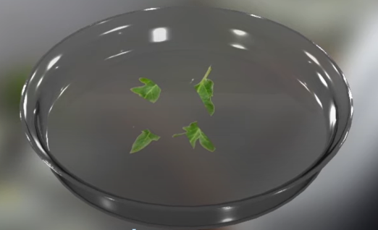
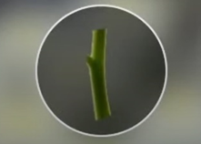
Technique of tissue culture:- can be divided into four stages
stage1st : Initiation Step
small tissue pieces or organs are removed from a donor plant and washed in water, sterilized and placed on a medium. (called an explant) under sterilized conditions. The surface sterilization of explant in chemical solutions is an important step to remove contaminants with minimal damage to plant cells. The most commonly used disinfectants are sodium hypochlorite, calcium hypochlorite, ethanol and mercuric chloride (HgCl2). The cultures are incubated in growth chamber either under light or dark conditions according to the method of propagation.
Stem

Slide 4
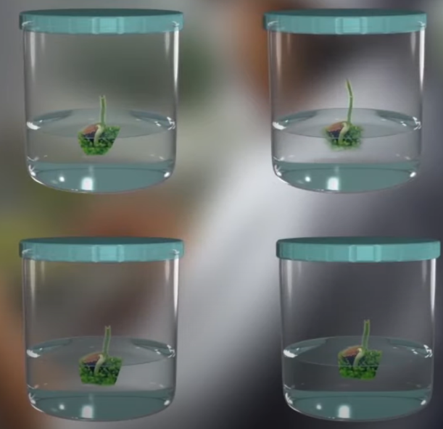
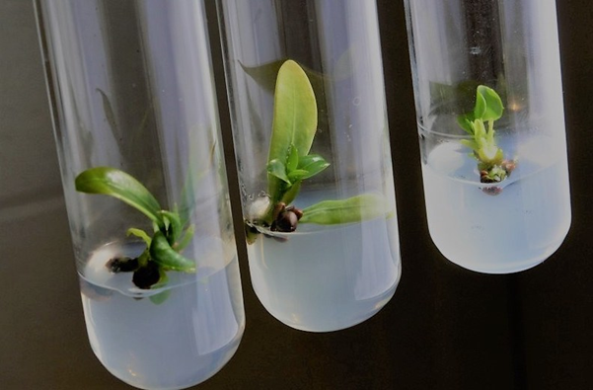
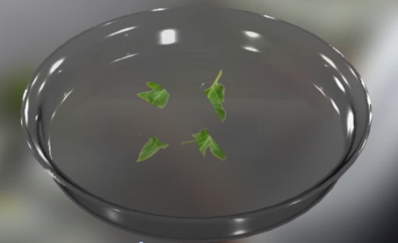
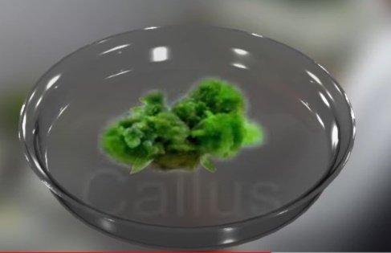
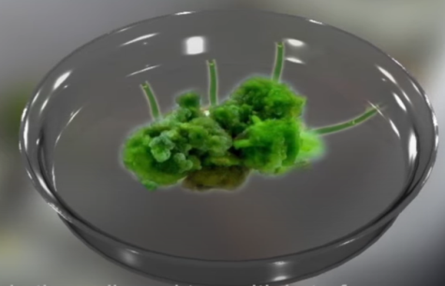
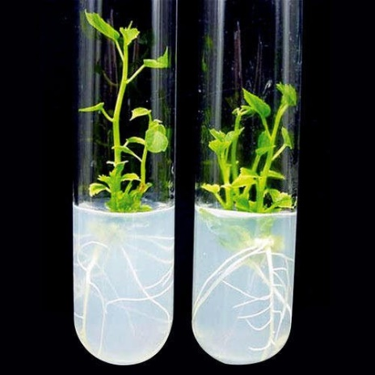
Technique of tissue culture
2st step: Multiplication stage
Multiplication stage. A growing explant can be induced to produce vegetative shoots
3st step: Rooting stage
Rooting stage. Growing shoots can be induced to produce roots

Slide 5
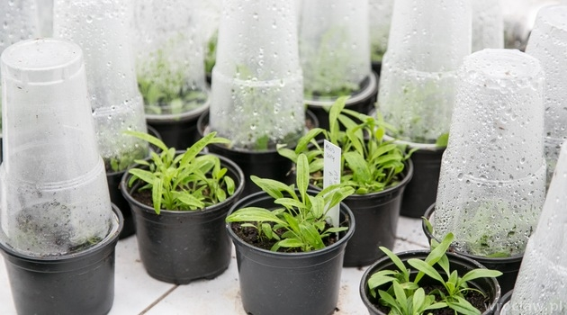
4st step: Acclimatization stage
growing, rooted shoot can be removed from tissue culture and placed in soil hardening is done gradually from high to low humidity and from low light intensity to high light intensity. The plants are then transferred to an appropriate substrate (sand, peat, compost etc.) and gradually hardened under greenhouse .

Slide 6
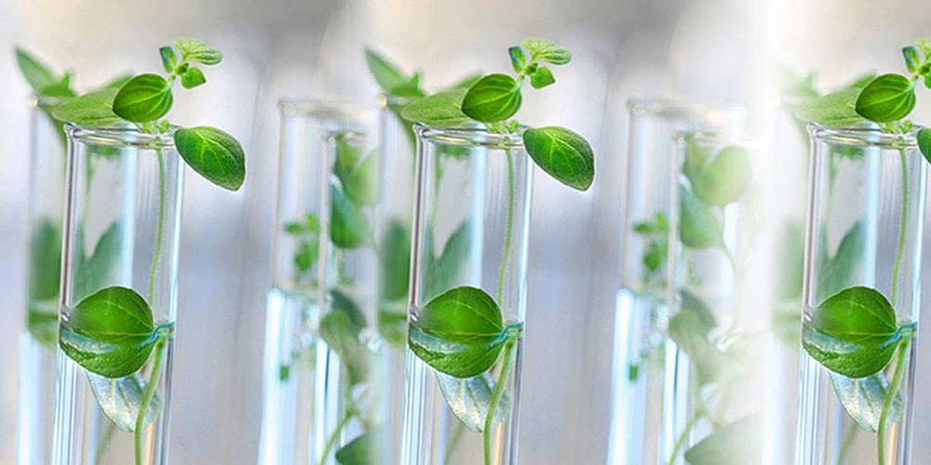
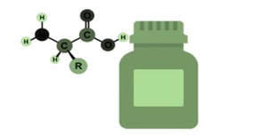
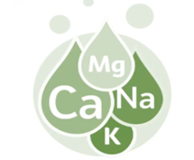
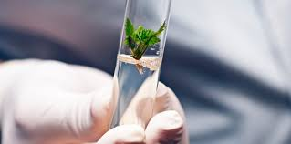
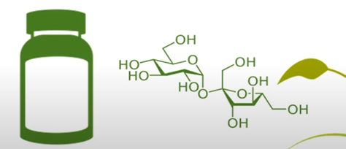
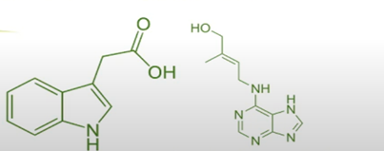
Basic component of plant culture media includes
organic supplement (vitamin or amino acids)
Essential elements like mineral ions, salts(macro and microelements required for plant growth)
source of carbon, usually supplied as sugar source
Plant hormones (Auxin/cytokinin)for growth regulator
PH is adjusted between 5 & 5.8 before gelling and sterilization PH below 5 will not gel properly. PH above 6 may be too hard.
solidifying agent such as agar

Slide 7
Plant tissue culture medium contains all the nutrients required for the normal growth and development of plants. It is mainly composed of macronutrients, micronutrients, vitamins, other organic components, plant growth regulators, carbon source and some gelling agents in case of solid medium . Murashige and Skoog medium (MS medium) is most extensively used for the vegetative propagation of many plant species in vitro. The pH of the media is also important that affects both the growth of plants and activity of plant growth regulators. It is adjusted to the value between 5.4 - 5.8. Both the solid and liquid medium can be used for culturing. The composition of the medium, particularly the plant hormones and the nitrogen source has profound effects on the response of the initial explant.

Slide 8
Plant growth regulators (PGR’s) play an essential role in determining the development pathway of plant cells and tissues in culture medium. The auxins, cytokinins and gibberellins are most commonly used plant growth regulators. Auxins and cytokinins are most widely used plant growth regulators in plant tissue culture and their amount determined the type of culture established or regenerated. The high concentration of auxins generally favors root formation, whereas the high concentration of cytokinins promotes shoot regeneration. A balance of both auxin and cytokinin leads to the development of mass of undifferentiated cells known as callus.

Slide 9
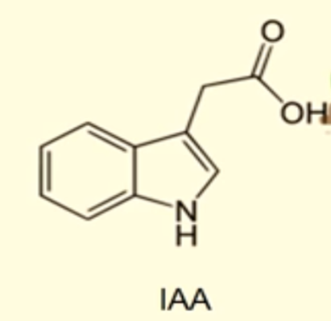
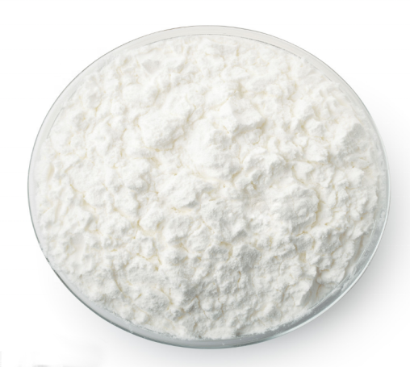
Auxin
Growth promoting chemicals
Promote cell division and cell elongation
Primary plant auxin is Indoleacetic acid (IAA)
Common synthetic forms of auxins are indole- 3butyric acid (IBA), NAPHTALENE- ACETIC ACID(naa), 2,4 dichlorophenoxyacetic acid(2,4D)

Slide 10
Cytokinins
Cytokinins promote cell division, and influence the cell cycle. Embryogenesis and inhibit root formation. The most cytokinins used are 6- benzylaminopurine (ABP), 6-benzyladenine. The most naturally occuring cytokini are zeatin and 2-ip

Slide 11
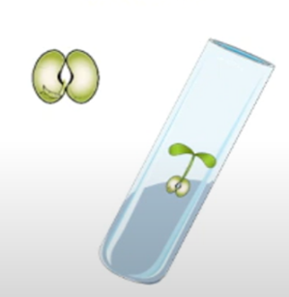
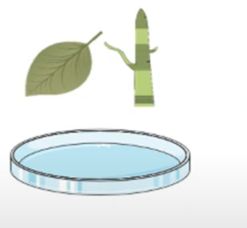
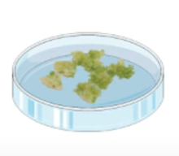
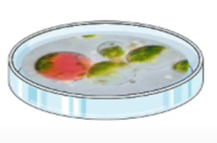
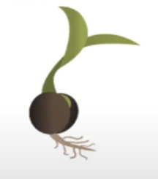
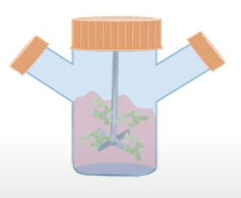
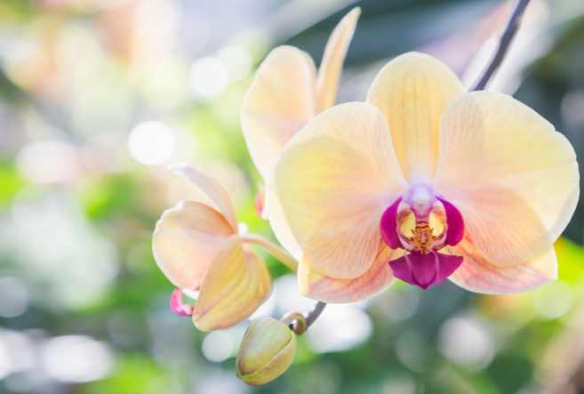
Types of culture system in plants
Seeds culture
Embryo culture
Organ culture
Callus culture
Cell suspension culture
Protoplast culture
1-Seed Culture
Seed culture is the type of tissue culture that is primarily used for increasing
efficiency of germination of seeds that are difficult to germinate in vivo such as
orchids

Slide 12
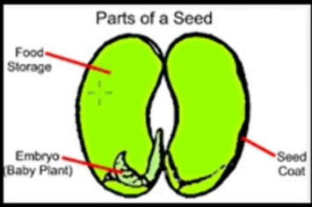
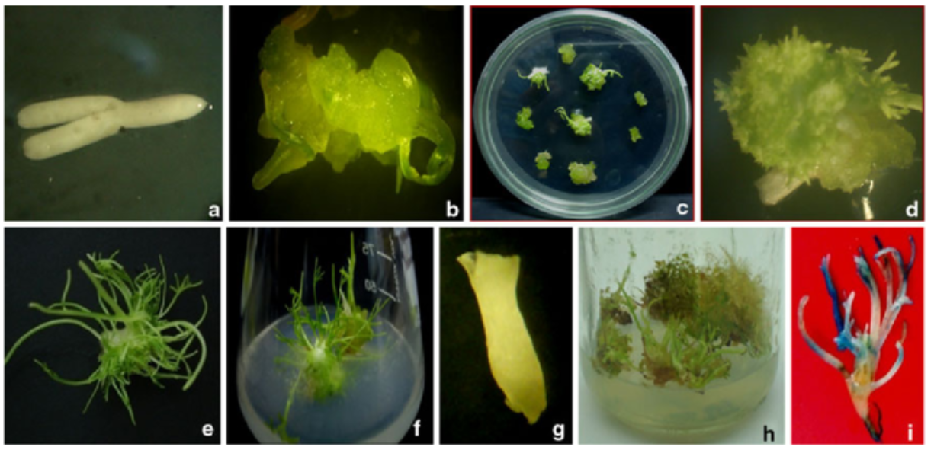
Types of Tissue Culture
2-Embryo Culture
Embryo culture is the type of tissue culture that involves the isolation of an embryo In addition, conservation of endangered species can also be attained by practicing embryo The plant has a high economic value for timber wood and for medicinal purposes culture technique from a given organism for in vitro growth.It used ti produced haploid plants and parasitic plants.

Slide 13
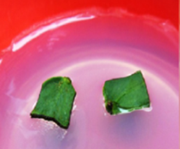
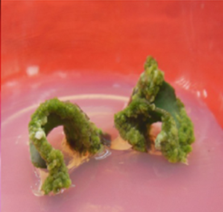
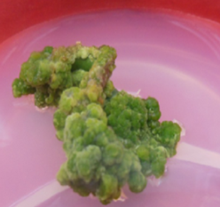
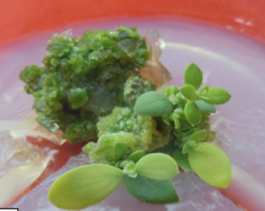
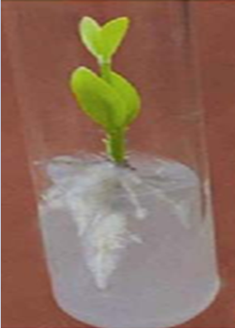
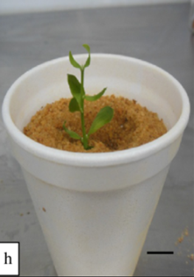
3- Callus culture
Callus formation in plants
Plant callus is a growing mass of unorganized plant paranchyma cells. Plant callus (plural calluses or calli). In living plants, callus cells are those cells that cover a plant wound. In biological research and biotechnology callus formation is induced from plant tissue samples (explants) after surface sterilization and plating onto tissue culture medium in vitro (in a closed culture vessel such as a Petri dish).The culture medium issupplemented with plant growth regulators, such as auxin, cytokinin,

Slide 14
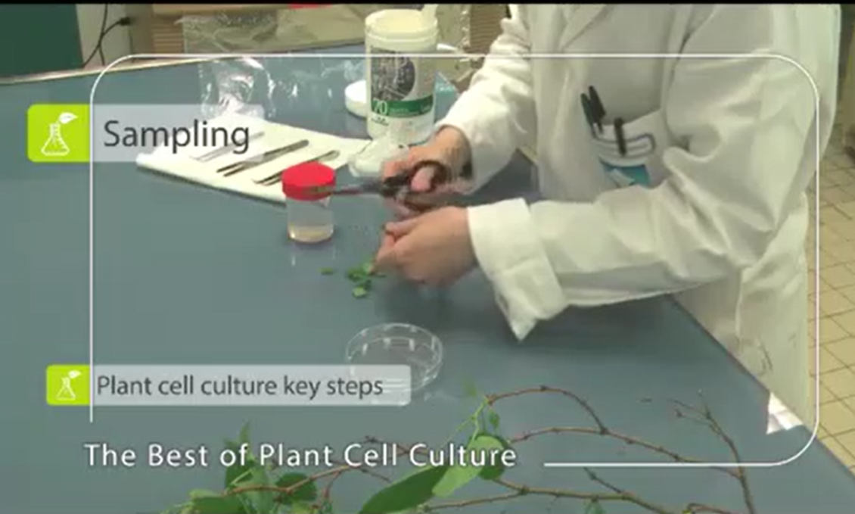
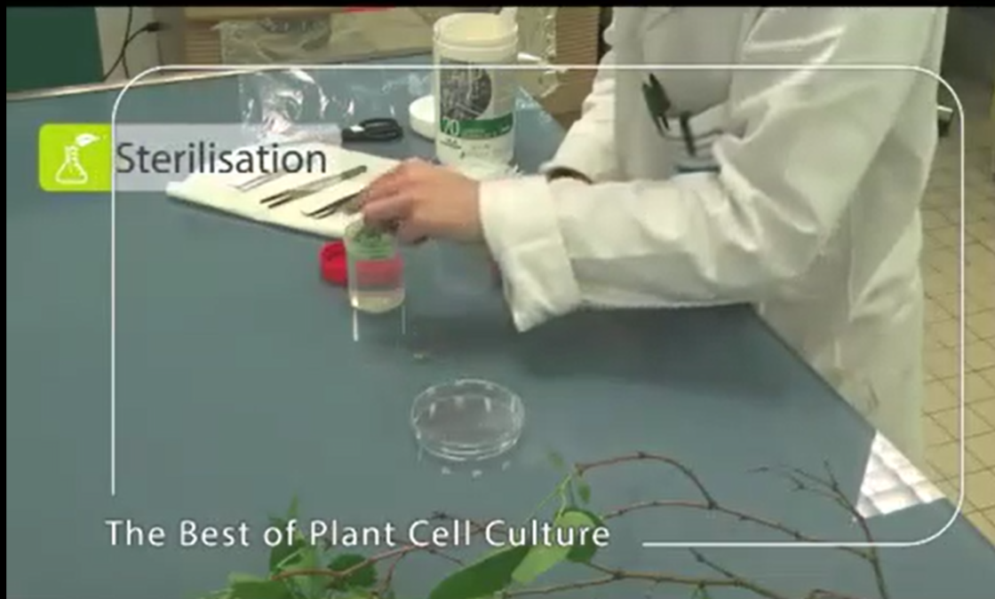
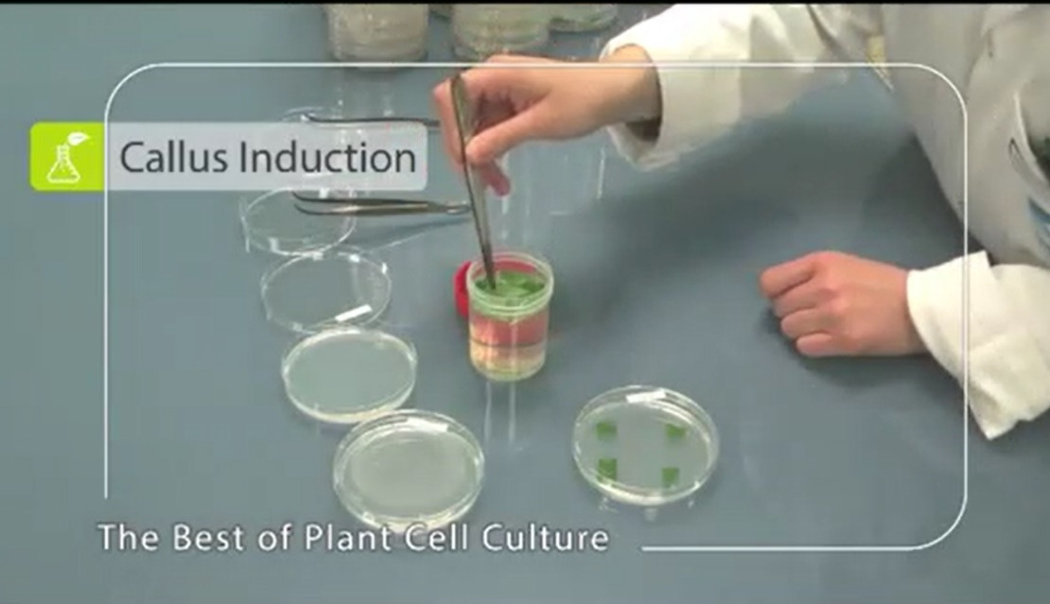
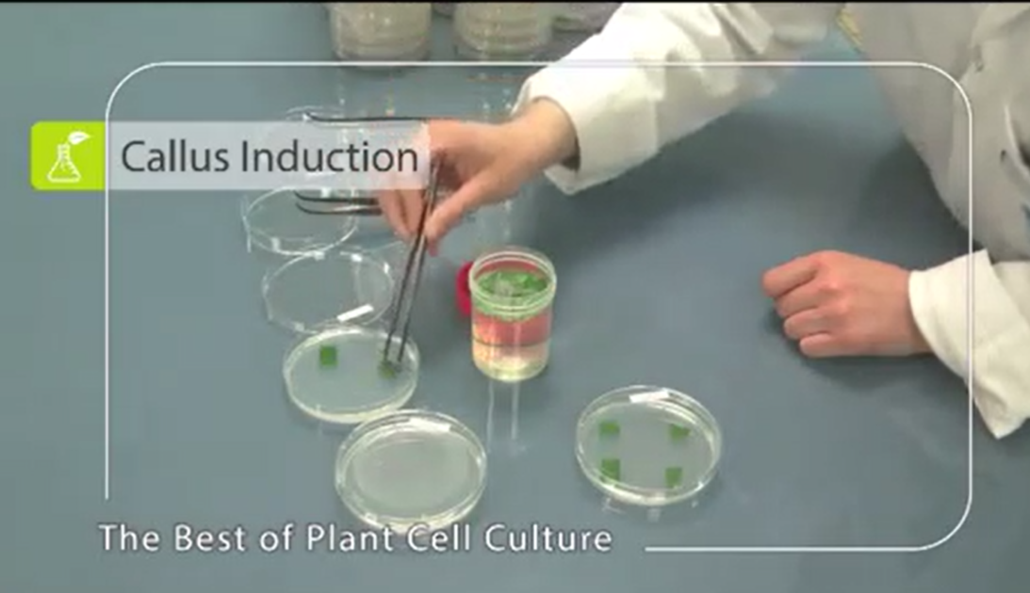

Slide 15
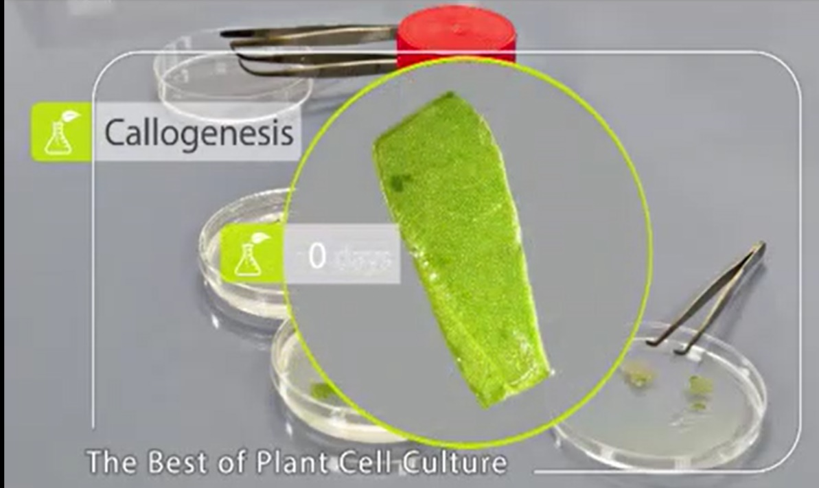
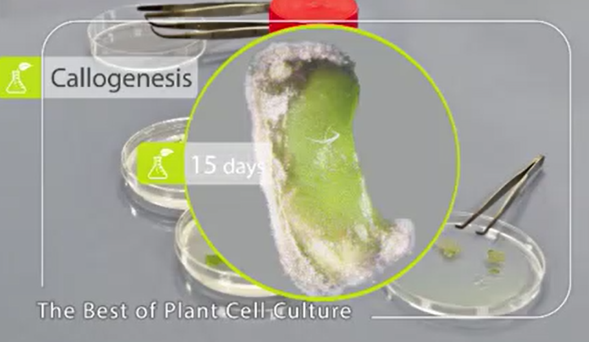
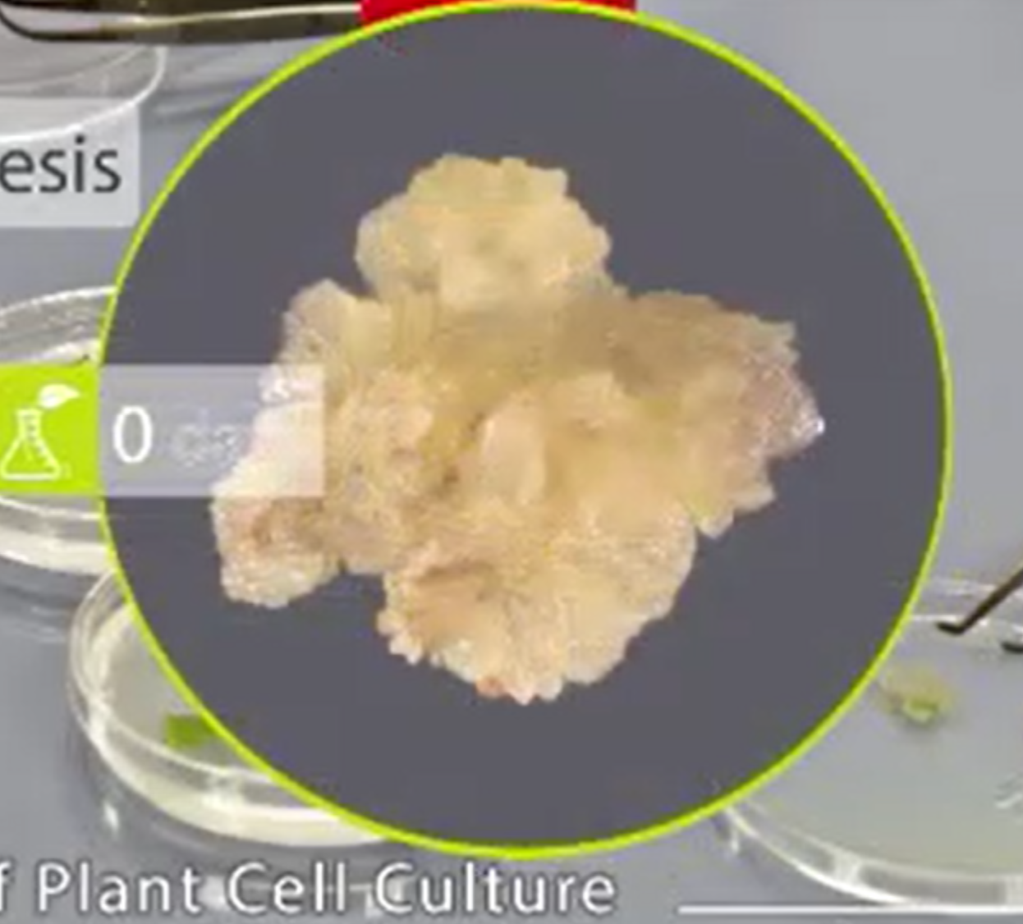
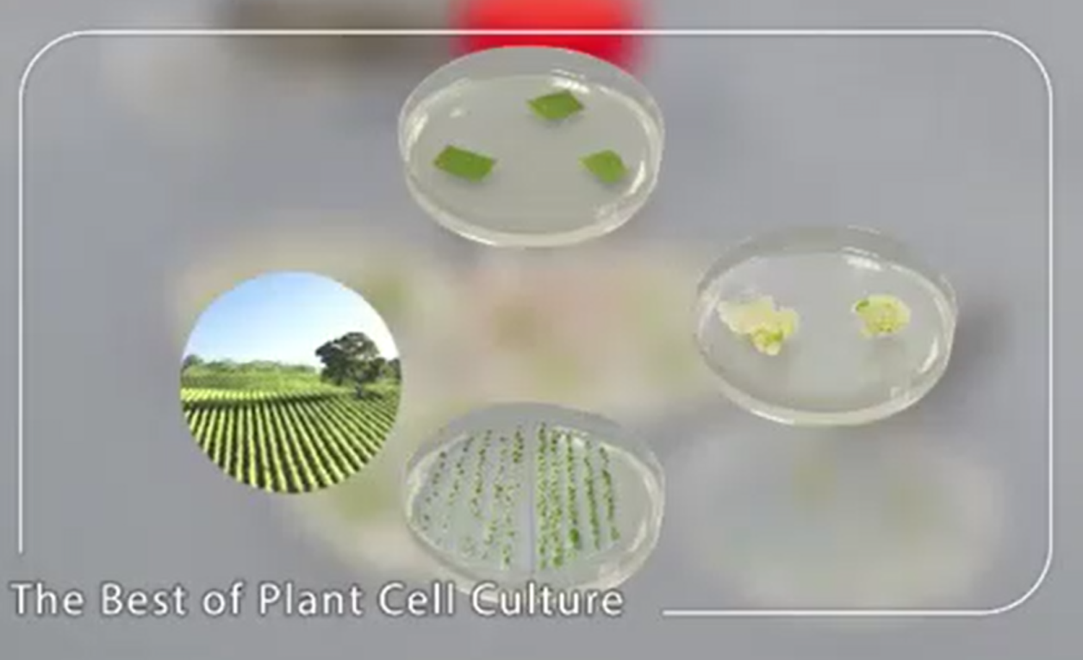

Slide 16
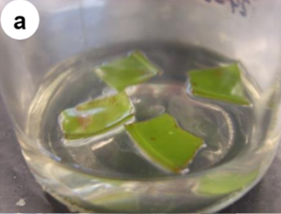
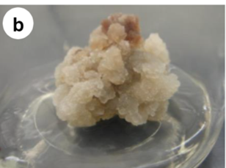
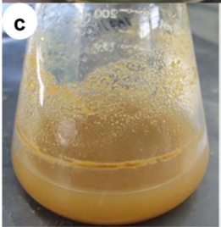
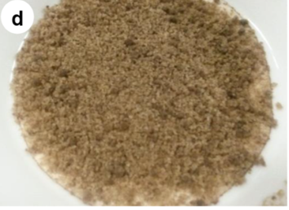
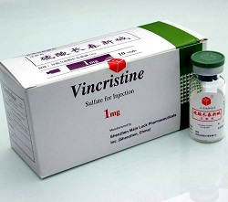
4- cell suspension culture is a sterile (closed) system normally initiated by aseptically placing friable callus fragments into a suitable sterile liquid medium. The explants are placed on different solid growth media; in successful media, callus tissue will appear on the explants in the course of 2–6 weeks A whole plant can be regenerated from a single plant cell.
Production of diosgenin has been carried out from cell suspension cultures of different explants diosgenin is used for the commercial synthesis of cortisone, progesterone, and other steroid products.
production of vincristine and vinblastine
is a chemotherapy medication used to treat a number of types of cancer.

Slide 17
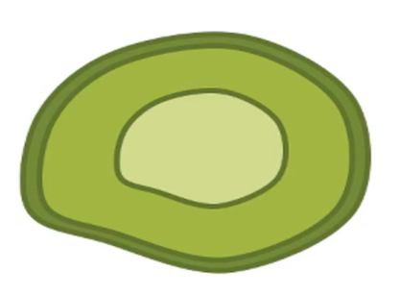
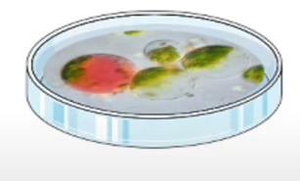
5-Protoplast culture
Protoplasts can be generated by stripping the cell wall from plant cells protoplasts are widely used fro DNA transformation. Growth of protoplasts into callus and regeneration of shoots requires the proper balance of plant growth regulators in the tissue culture
medium that must be customized for each species of plants.

Slide 19
6- Organ Culture
Organ culture is a type of tissue culture that involves isolating an organ for in vitro growth. Here, any organ plant can be used as an explant for the culture process (Shoot, root, leaf, and flower).

Slide 20
1- Cultivation many plants do not germinate, flower and produce seed under certain climatic conditions or have long periods of growth and multiplication. Tissue culture insures a good regular supply of medicinal plants, using minimum space and time.
2- Produce secondary metabolites: Medicinal aromatic plants, which are source of secondary metabolites, have been used for treatment and other purposes since ancient times. In recent years, people have preferred medicinal and aromatic herbs to be healthy. Increasing population and increasing demand for herbal products, unconscious collection and illegal trade cause the extinction of medicinal plants in natural habitats. Therefore, it is important to cultivate medicinal and aromatic plants to protect biodiversity and endangered species. As a result, plant tissue culture methods are an alternative way for propagation of medically and economically important plants, the production of bioactive components for the pharmaceutical industry, and the production of medically important secondary metabolites

Slide 21
3. Genetic Manipulations
4. Plants are a promising expression system for the production
of recombinant proteins:- particularly important classes of pharmaceuticals: vaccine antigens, therapeutic proteins, and antibiotics and enzymes.
Plant transformation is a way to insert DNA from another organism- normally another plant, into the genome of a plant of interest.

Slide 22
There are 2 main methods for gene delivery in plants; Agrobacterium and the particle gun.
Agrobacterium is a naturally occurring soil bacteria, which has the unique ability to transfer part of its own DNA into plant cells. In the wild, transfer of some of the bacterial DNA causes rapid plant cell division, and the development of a plant tumour. In the lab we harness the DNA transfer ability of Agrobacterium, but remove the ‘tumour forming’ genes- instead replacing these with our genes of interest. We inoculate Agrobacterium containing our genes of interest, onto wounded plant tissue explants. The Agrobacterium then transfers the gene of interest into the DNA of the plant tissue.

